Slide 1


Octantis SUV T800:
Modeling the Optimal Media Mix for 2020 Sales
prepared by
Team A
Notes:
-Greet the judges (Ikechi, Fabio, Daria, Brandon, Stephanie, Hanna, Ashley)
-Today we will be presenting our analysis of the 2018 & 2019 Octantis media mix and proposing a model which will help the company optimize its media mix in 2020… barring any wild unforeseen events such as a pandemic, historic inflation, land war in Europe, etc.

Slide 2






Our Team
Linh Chi Ha (MS Business Analytics)
Jinny Lee (MS Information Systems)
Rocio Noriega (MS Business Analytics)
Paul Hoover (MBA)
Olympia Lala (MS Quantitative Methods)
Notes:
-Each member of this team worked day in and day out the past four days to produce the model you will see today… and I made the deck look pretty!
-Acknowledge the tremendous skill and indefatigable spirit of my colleagues. We hope you like what you’re about to see!

Slide 3
The Problem:
UNDERSTAND
Top factors affecting unit sales of T800 from 2018-2019
01
OPTIMIZE
2019 media budget to drive maximum sales in 2020
02
FORECAST
How many T800s are expected to sell in 2020
03
Notes:
At issue in this presentation:
Understand the factors affecting T800 Sales
Optimize the media mix to drive more SUV sales (pun intended)
Forecast expected T800 sales in the coming year

Slide 4
Explaining the Data Set
Weekly Metrics
Geography, Product, Campaign, Outlet, Creative, Period, Variable Name, Category (Merged)
Dependent Variable (our KPI)
Octantis Retail Sale Units
Data Cleaning & Preprocessing
Regrouped variables by important factors:
Seasonality, GFK brand metrics, Media Channels/KPIs, etc.
Picked non-collinearity variables for our final model
Replaced all the missing values with zero (0)
01
UNDERSTAND
Top factors affecting unit sales of T800 from 2018-2019
Notes:
Removed correlated variables
&grouped some to fit into multilinear regression model
Rip from their presentation slide
Don’t spend too much time on this
GFK Brand Metrics
Seasonality

Slide 5
t800 Sales & Media Spend, 2018 – 2019
Notes:
Here we have plotted the 4-week moving average of units sold against the total weekly media spend, both direct and halo. Immediately you notice that while direct spend was cut substantially in 2019, the moving average stays within the 600-800 range. So which factors had the greatest impact on units sold?
To answer this, I will turn it over to my colleague Chi, who was the main architect behind our model.

Slide 6
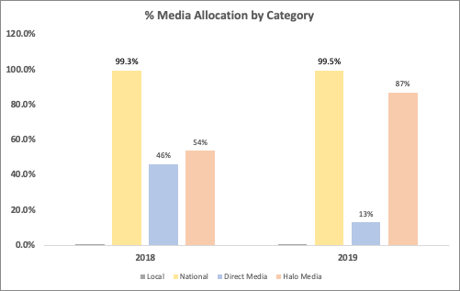
Octantis Media Spending by Year
01
Notes:
Highlights reallocation from Direct to Halo
Turn to Chi for model breakdown

Slide 7




Key Factors Impacting Sales:
01
Category | term | estimate | std.error | statistic | p.value | Signif.code
 | (Intercept) | 1695.7463 | 620.07096 | 2.7347616 | 0.0088977 | **
CompetitionSpending | lag(total_competitive_media_spend, 4) | -4.32E-07 | 1.89E-07 | -2.2804216 | 0.0273706 | *
Competition | gfkCompConsider | -1541.7144 | 830.01734 | -1.8574485 | 0.0697987 | .
MediaActivity | lag(DISPLAY_DIRECT_CLICKS, 3) | -2.33E-05 | 1.74E-05 | -1.3335225 | 0.1890715
MediaActivity | lag(DISPLAY_HALO_CLICKS, 3) | -1.86E-06 | 1.26E-05 | -0.1473263 | 0.8835326
MediaActivity | lag(SEARCH_DIRECT_CLICKS, 3) | 6.24E-05 | 0.0001638 | 0.3807247 | 0.705199
MediaActivity | lag(SEARCH_HALO_CLICKS, 3) | 0.0001457 | 4.95E-05 | 2.945822 | 0.0050853 | **
MediaActivity | lag(SOCIAL_DIRECT_CLICKS, 3) | 0.0001414 | 5.69E-05 | 2.4859546 | 0.0167006 | *
MediaActivity | lag(SOCIAL_HALO_CLICKS, 3) | -2.42E-05 | 2.55E-05 | -0.9482289 | 0.3480776
MediaActivity | lag(TV_DIRECT_IMPRESSIONS, 9) | 3.88E-07 | 3.52E-07 | 1.1025666 | 0.2760773
MediaActivity | lag(TV_HALO_IMPRESSIONS, 9) | -1.28E-07 | 2.29E-07 | -0.5611266 | 0.577495
Seasonality | Holiday | -2.8284718 | 1.0727324 | -2.6366983 | 0.0114495 | *
Seasonality | BeforeHoliday | 0.2817592 | 1.2288442 | 0.229288 | 0.819684
Seasonality | AfterHoliday | 0.4342448 | 1.2822196 | 0.3386665 | 0.7364362
Seasonality | SaleEvents | -0.0491289 | 0.9253357 | -0.0530931 | 0.9578927
Media Activity (Display, Search, Social, TV)
Brand Metrics
(competitor’s purchase consideration)
Seasonality | season2 | -147.52441 | 84.0058 | -1.7561218 | 0.0858719 | .
Seasonality | season3 | -91.407537 | 81.290822 | -1.1244509 | 0.2667842
Seasonality | season4 | 73.822895 | 80.06309 | 0.922059 | 0.3614152
Seasonality | season5 | 158.31946 | 68.378258 | 2.3153479 | 0.0252104 | *
Seasonality | season6 | -263.93287 | 74.706466 | -3.5329321 | 0.0009633 | ***
Seasonality | season7 | -113.23299 | 76.896845 | -1.472531 | 0.1478378
Seasonality | season8 | -27.224298 | 71.829297 | -0.3790138 | 0.7064601
Seasonality | season9 | 307.81638 | 69.852057 | 4.4066902 | 6.43E-05 | ***
Seasonality | season10 | -352.13875 | 72.605472 | -4.8500305 | 1.51E-05 | ***
Seasonality | season11 | -149.82642 | 74.201752 | -2.0191763 | 0.0494498 | *
Seasonality | season12 | 85.733352 | 75.683609 | 1.1327863 | 0.2633037
Seasonality | season13 | 304.87274 | 70.83201 | 4.3041662 | 8.94E-05 | ***
Seasonality
Competitor Media Spend
Adjusted r² = 0.78
Notes:
Using this model, we isolated the following key factors which correlated with the most variability in weekly sales:
Include screen shot of final model left hand
Right hand explain what does it mean negative vs. positive – impact on Unit Sales
By what PERCENT do variables impact Unit Sales (will cal
Factors include:
Media Activity (Display, Search, Social, TV)
Brand Metrics (competitor’s purchase consideration)
Seasonality
Competitor Media Spend
Include screen shot of final model left hand
Right hand explain what does it mean negative vs. positive – impact on Unit Sales
By what PERCENT do variables impact Unit Sales (will calculate from Coefficients)
culate from Coefficients)

Slide 8
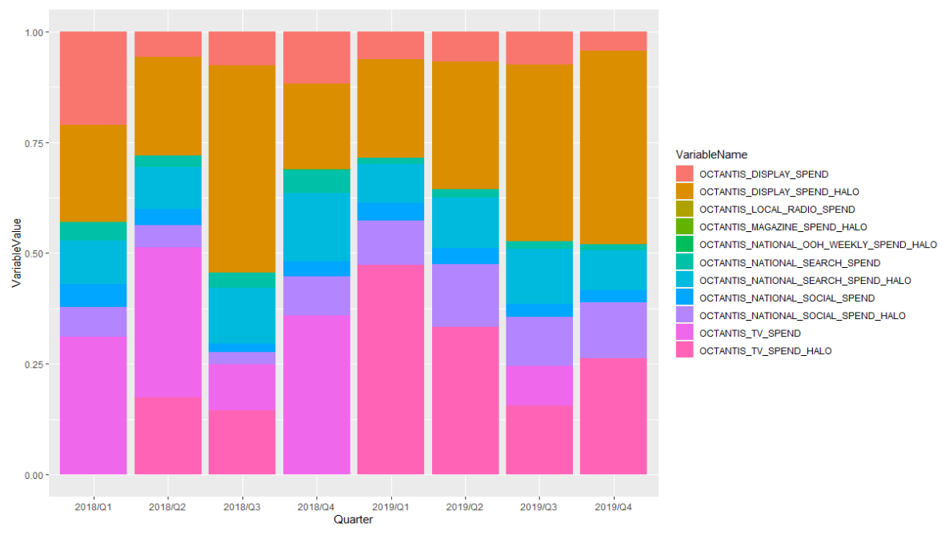
Octantis Media Spending by Quarter
01
Increase Spend on Search and Social
Reallocate budget from Display Ads to other channels
Increase spending on TV (Direct), and decrease spending on TV (Halo)
Watch out for Competitor’s Media Spend
Notes:
Using this model, we isolated the following key factors which correlated with the most variability in weekly sales:
Include screen shot of final model left hand
Right hand explain what does it mean negative vs. positive – impact on Unit Sales
By what PERCENT do variables impact Unit Sales (will calculate from Coefficients)
I uploaded an excel file of the model output, please use that for easier calculation or formatting: model_lag
some message (please also do the wording for me):
Search and Social having positive impact (while spending for Search and Social accounts for less % - next slide) -> basically we suggest them to spend more on Search and Social
Display Ads seem to have negative impact while they spend nearly 40% of spending on Display -> reduce it
Spend more on TV Direct, less on TV Halo
Sales Event does have an positive impact on our sales -> can do more campaign or sth to boost the sales
Watch out for competitor’s media spend as both their spend and the consider having negative impact on our sales

Slide 9
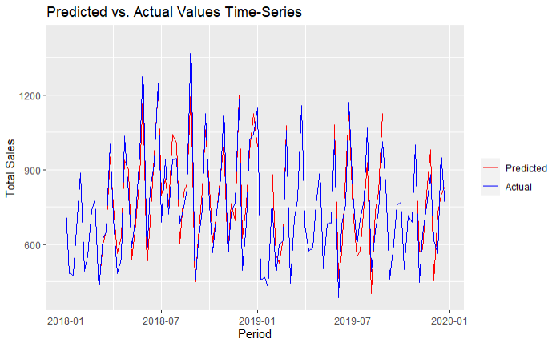
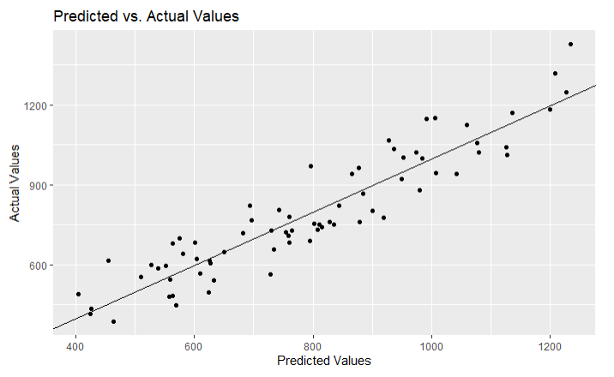
Current model

Slide 10
Proposed Media Mix
02
Channels | 2019 Budget | New allocated budget
OCTANTIS_DISPLAY_SPEND | 6% | 5%
OCTANTIS_DISPLAY_SPEND_HALO | 34% | 10%
OCTANTIS_NATIONAL_SEARCH_SPEND | 2% | 10%
OCTANTIS_NATIONAL_SEARCH_SPEND_HALO | 10% | 15%
OCTANTIS_NATIONAL_SOCIAL_SPEND | 3% | 10%
OCTANTIS_NATIONAL_SOCIAL_SPEND_HALO | 12% | 15%
OCTANTIS_TV_SPEND | 2% | 20%
OCTANTIS_TV_SPEND_HALO | 31% | 15%
Notes:
-Insert a pie graph comparing 2019 media mix to 2020, illustrating key changes

Slide 11
Building the Ideal Media Mix
Increase spending on Search
Increase spend on Social
Increase spend on TV_Direct
Reduce spend on Display
Reduce spend on TV_Halo
02
OPTIMIZE
2019 media budget to drive maximum sales in 2020
Notes:
Given what we know about these

Slide 12
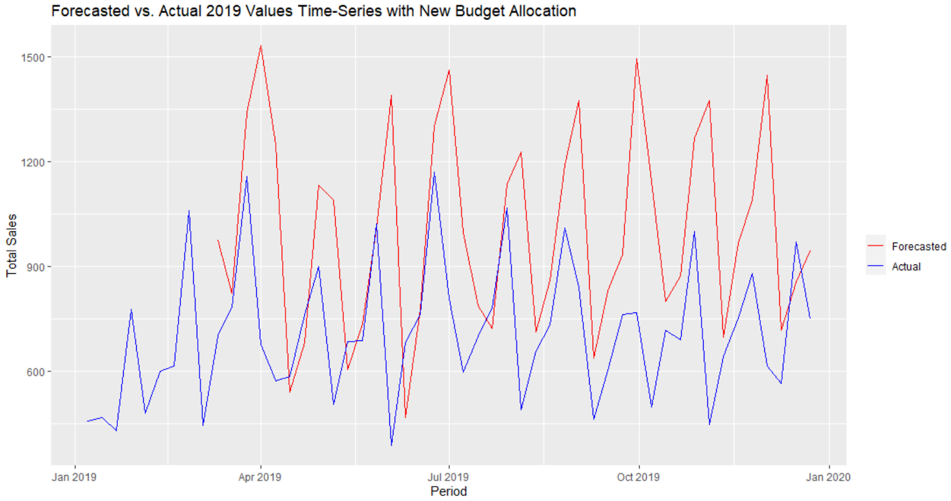
Sales anticipated by our model
03
FORECAST
How many T800s are expected to sell in 2020
(from Week 10 – Week 52, adjusted for lag time)
Total sales 2019: 30,837
Total sales 2020: 42,192
Upside 13.9%
Notes:
If Octantis makes the changes recommended, our Model projects a 14% increase in sales in 2020 without spending another dime on advertising

Slide 13
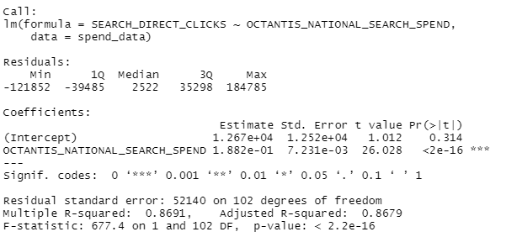
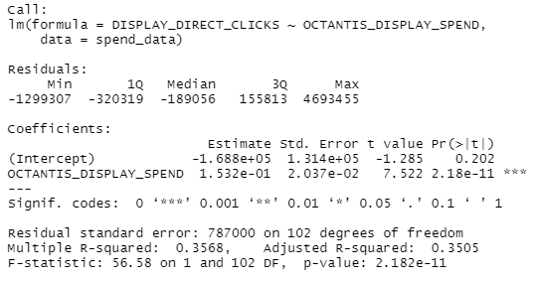
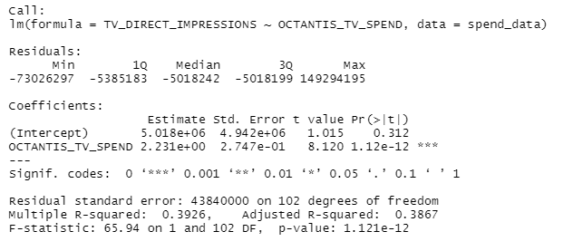
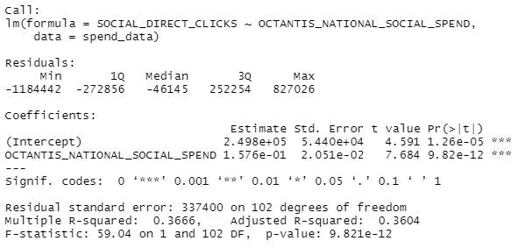
Media Spend and Media Activity are well correlated, meaning a change in budget allocation will likely be reflected in the Media Activity as demonstrated below:
Search:
Display:
TV:
Social:
Notes:
-Insert a pie graph comparing 2019 media mix to 2020, illustrating key changes

Slide 14
Further Reflection…
Based on our experience digesting this data set, our Group would suggest the following improvements to Octantis’s marketing approach:
Reallocate local spend to the lower-sales regions instead of evenly distributing local spend
Increase spend on Search, Social, and TV (Direct)
Increase Sales Events
Reduce spend on Display Ads and TV (Halo)

Slide 15
THANK YOU! (Q&A)
prepared by
Team A
Notes:
Thank you for your time this morning, and at this point we will open the floor to questions.

